Slide 1
Physician Suicide
Janae Sharp
@CoherenceMed

Slide 2
THE FACTS
More than half of US physicians are experiencing burnout
Physicians who are at risk have more medical errors.
Total costs of errors and physician suicide are not well known
Each year we lose around 400 physicians to suicide.
Over one million patients lose their Doctor to suicide each year.
Research about suicide and root causes of burnout is mixed

Slide 3
Clean layout for business project

Slide 4
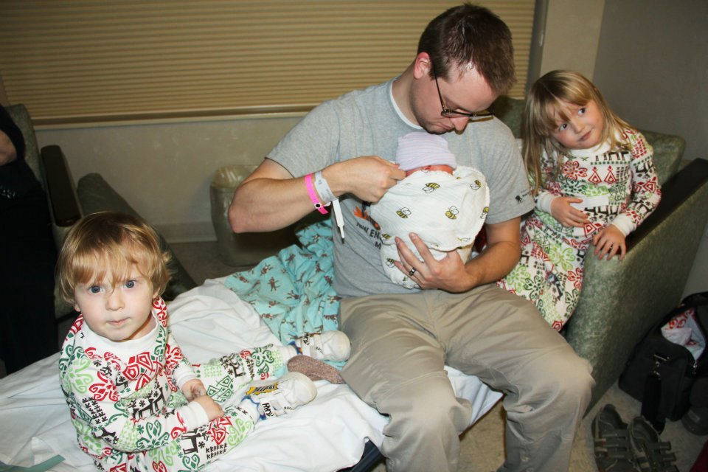

Slide 5
Suicide rates up 24% from 1999-2014 [1]
Suicide was 10th leading cause of death in US [1]
Rates of suicide in middle age men 45-64, up 43% [1]
Rates of suicide in white women, up 63% [1]
1000 Units of Insulin: Physician Suicide
MD suicides: 70% higher than rates than other professionals [2,3]
Female MDs: 250 to 400 percent higher [2,3]
MDs also have higher completed suicide rate [2,3] Suicide rate (including “accidental overdose”) is likely higher
Higher rates: anesthesiologists and psychiatrists [4]

Slide 6
Only 26% of surgeons with suicidal ideation in the previous year had sought care from a mental health provider compared to 44% for individuals in the general population. [17]
Notes:
Grief and the Secret
Wellness Band-Aids and Physical Realities of Physician Training and Work
Licensing boards
60% reported that this was due to concerns about medical licensing boards. [18]
80% of state medical boards inquire about mental illness on initial licensure applications and 47% on renewal applications. [19]
Professional culture of perfectionism

Slide 7
Physician Mental Health and Substance Abuse
Mood and substance issues risk factors for suicide
“Suicide is seen as the outcome of a complex, multifactorial process involving the interplay of many variables rather than just a byproduct of mental illness.” [10]
Depression[6]
MD depression rates are the same as in other populations. [7]
Substance use
MD rates of substance use are 10-15% [8] (compared to 9% nationwide [9])
Mental Health
Anxiety, bipolar disorder, personality disorders [6]

Slide 8
Blame the Technology
2017 was the year of the Electronic Health Record as Burnout Villain
Influx of articles about EHR and burnout
Notes:
More clerical, less clinical
52% of time spent in EHR of 11.5 hour work day [14]
1.4 hours during MD personal time [14]
Only 32.1% “medical care.” [14]
Physicians more prone to burnout as a result of EHRs [15]

Slide 9
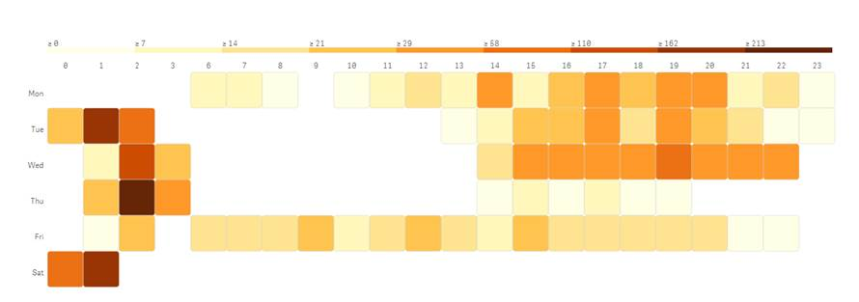
EHR Data Shows
Workforce Health

Slide 10
Coping tools and support have been shown to decrease burnout rates
When physicians receive support and learn strategies that work, their stress and burn out levels go down. However, providers are reluctant to seek help out of fear of diagnosing and licensing boards.
We are offering a platform to provide transdiagnostic, anonymous online help with access to evidence-based tools and weekly, virtual peer support.
sharpindex.org

Slide 11
We asked if respondents WANTED to be contacted personally at the end of the survey
12 %
Asked to be texted
Lowest Stress
Correlated with mental health support
107 Responses
Flagged for concern

Slide 12
We reach a greater number of female physicians with the Sharp Index.
Health IT Industry media
Social Media and Health IT media outlets have some traffic
Television Media
Shared our story online not the Nonprofit.
ZDogg MD
Podcasts and Shows drive the most traffic

Slide 13
Male Respondents were more likely to respond that they would like a text contact and include their phone number.
22% of Men
Wanted to be contacted via text
11% of Women
Wanted to be contacted via text
Burnout Rate
Did not relate to opting in to a text

Slide 14
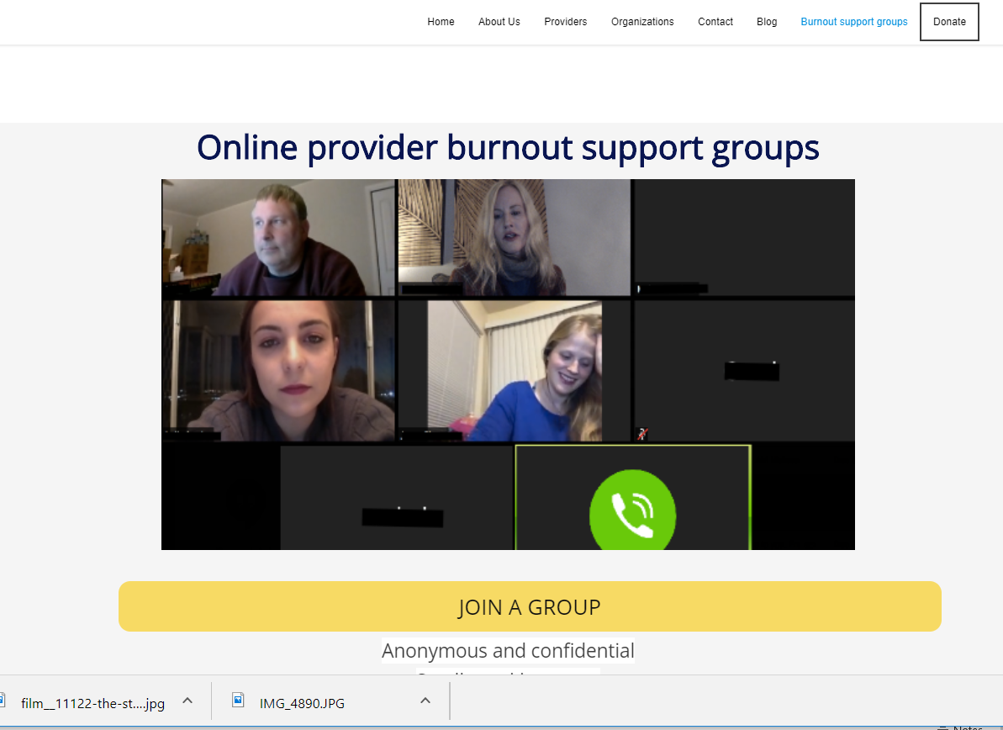
Notes:
Unspoken provider/patient dynamic is powerful
Thoughts and feelings of provider impact the patient
Positive Expectancy
Imparting hope to the patient that the treatment will work
NIH studied positive expectancy in the role of placebo effect
Patient expectations and beliefs have a profound impact on outcomes [22]
The dynamic between patient and clinician is very important and often determines whether the interaction is successful or not. Clinicians often focus on how the patient is reacting with little attention to their own thoughts, feelings or behaviors.
Often there is a parallel process in which the patient and clinician are having almost identical thoughts, feelings and behaviors. The clinician can often identify the thoughts, feelings and behaviors of the patient but fail to see how they are reacting in the same way.
By examining and working on their own triangle, the clinician can start to change the dynamic. Remember, systems theory suggests that if one person changes, the dynamic and trajectory changes.
POSITIVE EXPECTANCY:
research in anxiety (Colloca et al., 2004), depression (Chen et al., 2011; Rutherford et al., 2016) and pain (Bingel et al., 2011; Colloca et al., 2004) supports that the patients' expectancies and beliefs can have a profound influence on therapeutic outcomes.
“ practitioners can, through their relationships with their patients, and in conjunction with appropriate medical technologies, use a multitude of non-deceptive means to promote positive placebo responses.”
A confident practitioner, displaying strong beliefs in the diagnosis and treatment, can enhance positive expectancy in the patient, while a neutral or uncertain attitude could have little or even a negative effect on the patient.37,84,85
Programs and tools help
Self-awareness education program [29]
Mindfulness and communication
2.5 hour weekly for two months, then monthly group
Small-group discussion group [30]
9 months, 1 hour protected time
Decreases in burnout
Course: Recognizing and managing emotions
Acknowledging the impact and providing concrete education
Training physicians about emotions
How they get triggered during their work
How to recognize and safely process

Slide 15
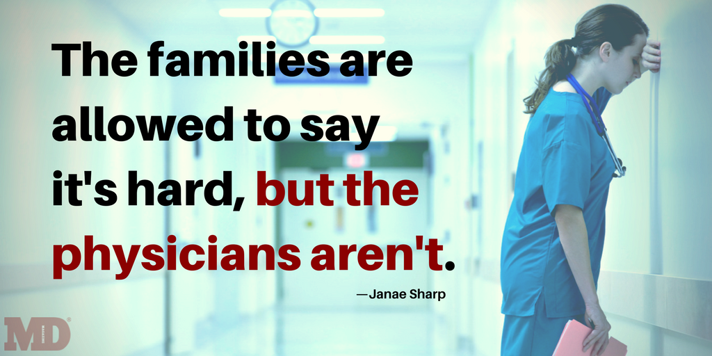

Slide 17
Questions
Twitter: @Coherencemed
https://www.linkedin.com/in/janaesharp
Janae@sharpindex.org

